Slide 1











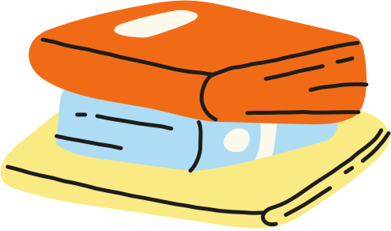
GEOMETRIC SOLIDS
DATE:_____________
INDICATOR: To identify properties and characteristics of solids and flat figures.
Fifth grade
Math

Slide 2


Warm-up!
https://www.youtube.com/watch?v=uZ8Jy1xgqPU&t=44s
3D Shapes Song for Kids
Let’s watch the following videos
https://www.youtube.com/watch?v=9pjDhl4dWN8
Volume Geometric Shapes with volume For Kids - Primary Vocabulary

Slide 3





What is the difference between these two sets of figures below?
In geometry, a solid is a three-dimensional shape or object that has length, width, and height. Solids are also known as three-dimensional shapes (3D shapes).
  Set A
  Set B

Slide 4



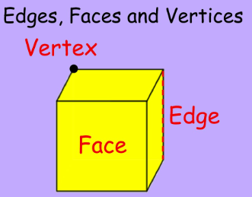

In geometry, faces, edges, and vertices are the three properties that define a three-dimensional shape.
Faces: The flat surfaces of a three-dimensional shape. Faces can be flat or curved.
Edges: The straight lines where two faces meet.
Vertices: The corners where two or more edges meet. The plural of vertex is vertices.
https://www.youtube.com/watch?v=eVDqk-39TZQ&t=1s
Properties of 3D Shapes | Faces, Edges, and Vertices of Prisms and Pyramids

Slide 5
Wrap-up:
Let’s Practice!

Slide 6
GEOMETRIC SOLIDS
DATE:_____________
INDICATOR: To identify properties and characteristics of solids and flat figures.
Fifth grade
Math

Slide 7
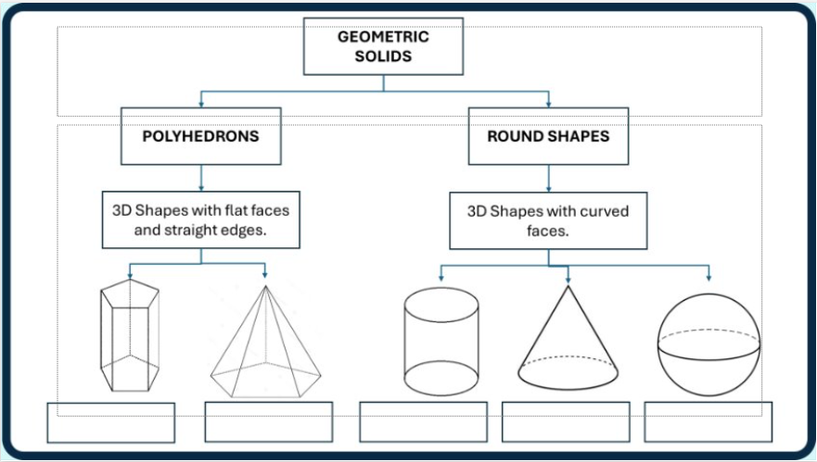
Pentagonal prism
Pentagonal pyramid
Cylinder
Cone
Sphere

Slide 8
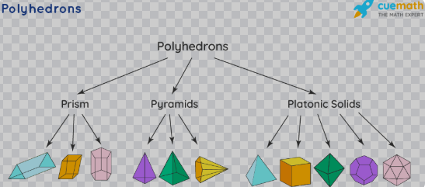
Pyramids are named after the shape of their bases.
Prisms are named after the shape of their identical opposite faces.
Also known as a polyhedron, with faces made up of only one type of regular polygon.
https://www.cuemath.com/geometry/polyhedron/

Slide 9
Wrap-up:
Let’s Practice!
https://wordwall.net/resource/26016904/math/3d-shapes

Slide 10
GEOMETRIC SOLIDS
DATE:_____________
INDICATOR: To identify properties and characteristics of solids and flat figures.
Fifth grade
Math

Slide 11
Warm-up!
Let’s watch the following video
https://www.youtube.com/watch?v=s7GrS0b3FRw&t=1s
3D nets explanation

Slide 12
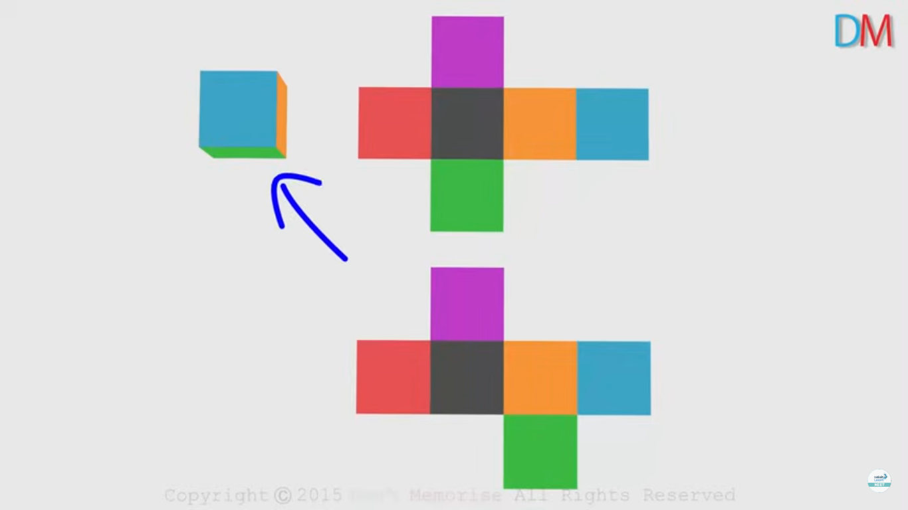
What is a net of a solid?
A net is a diagram which shows what the solid will look like when it is opened along its edges and laid flat.
  Net

Slide 13
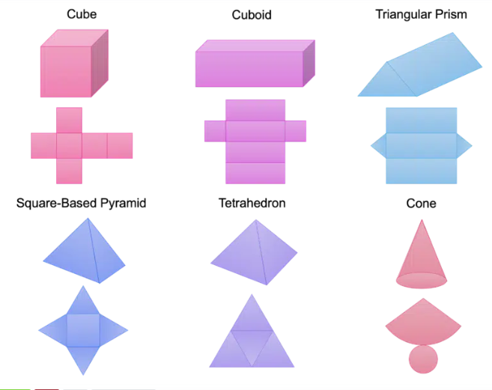
What is a net of a solid?
https://www.turtlediary.com/game/nets-of-3d-shapes.html

Slide 14
Wrap-up:
Let’s Practice!
Building a solid
Ind. 1 and 2

Slide 15

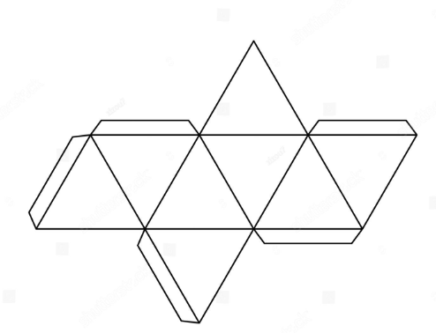
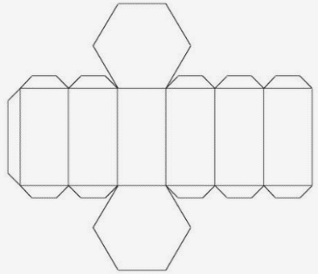
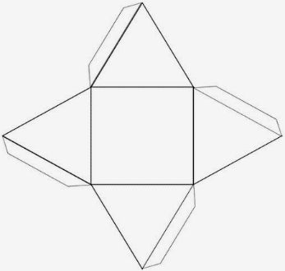
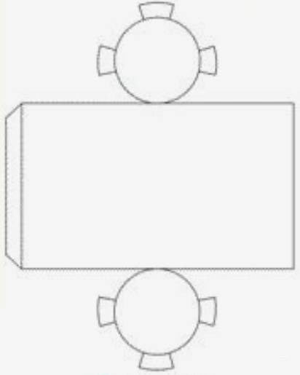
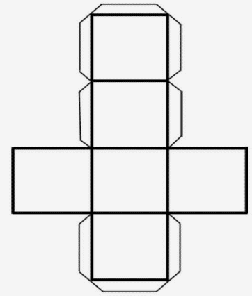
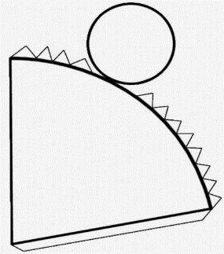
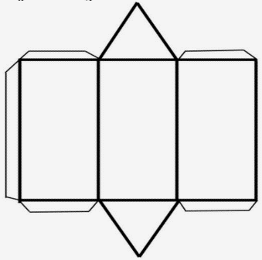
In teams of four students, choose one net from the figures below.
Paste the figure you chose on a cardboard and cut it by their edges.
Fold the tab and stick it.
The final solid must be well-pasted, neat, clean and decorated.
1 2 3 4 5 6 7

Slide 16
5. Answer how many faces, edges, and vertices does your solid have.
1 2 3 4 5 6 7

Slide 17
PRÁCTICAS MÍNIMAS
Solve exercise 11 page 68 and 12 page 69 of the book "Saber SABER".
(Copy dates on the pages)

