Slide 1
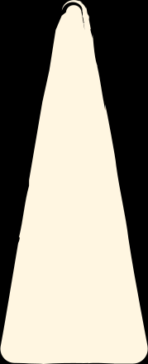
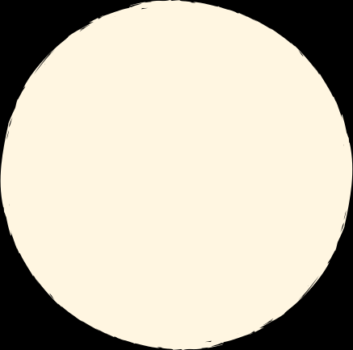



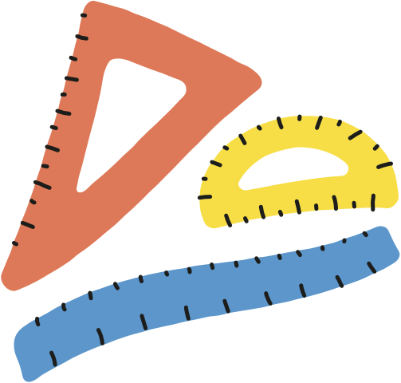


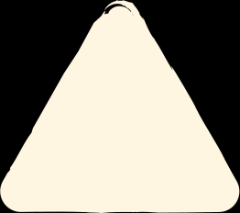


AREA
DATE:_____________
INDICATOR: TO DISCOVER DIFFERENT METHODOLOGIES TO FIND OUT THE AREA OF COMPOSITE FIGURES.
Fifth grade
Math
INSPIRED BY

Slide 2

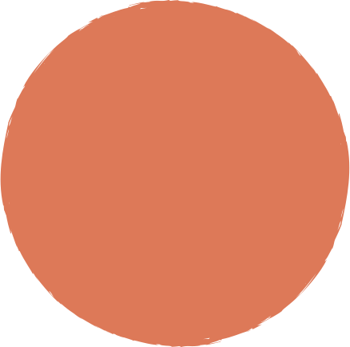

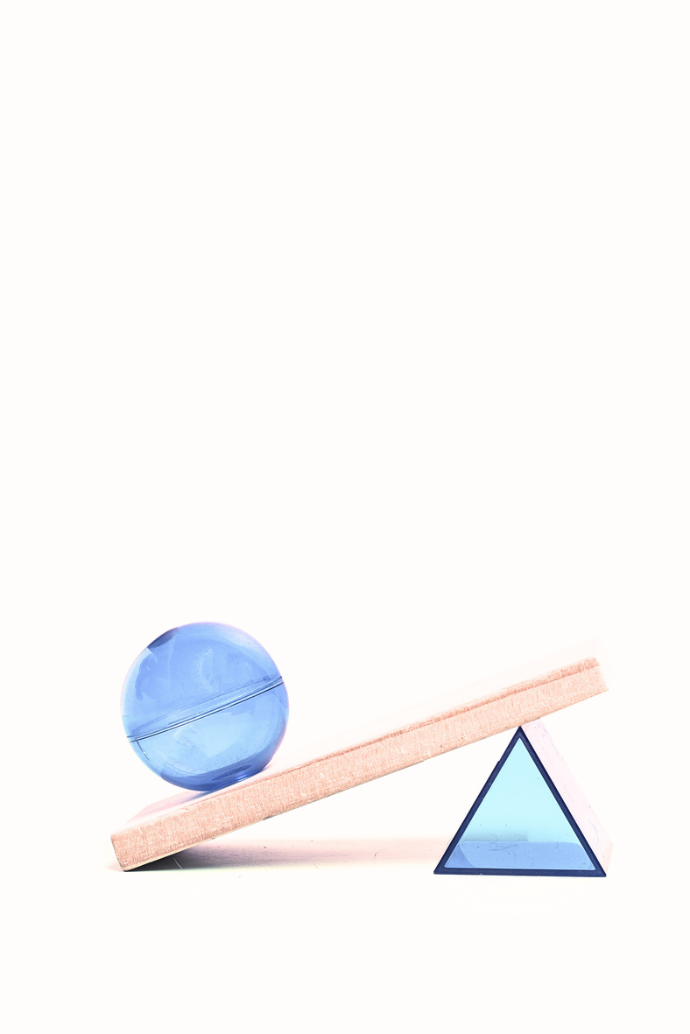
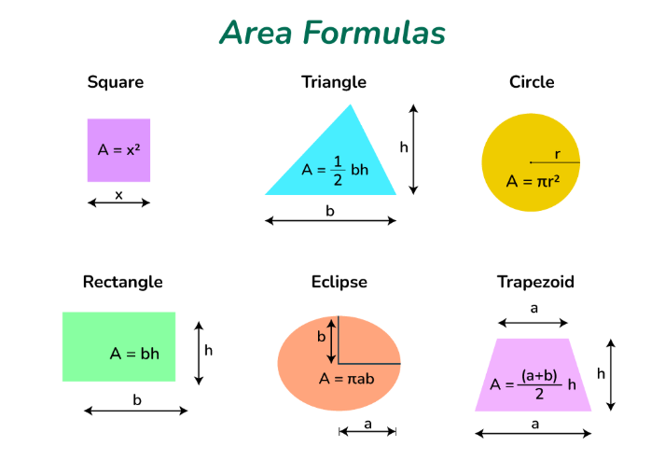

Warm-up!
Let’s watch the next video
https://www.youtube.com/watch?v=xCdxURXMdFY&t=155s
Math Antics - Area

Slide 3




Glossary of concepts
  Simple area: The area of a single, uncomplicated geometric shape. Examples include the area of a square, rectangle, triangle, or any other basic shape.
  Compound area : Also known as the area of a composite shape, this refers to the area of a figure created by combining two or more simpler shapes. For instance, a shape made of a rectangle and a triangle joined together.
  Shaded area: This refers to the area within a specific region or part of a shape that is visually distinguished from the rest of the shape, typically by shading or highlighting. For example, if a larger shape contains a smaller shape within it that is colored in, the area of the colored-in shape would be the shaded area.

Slide 4
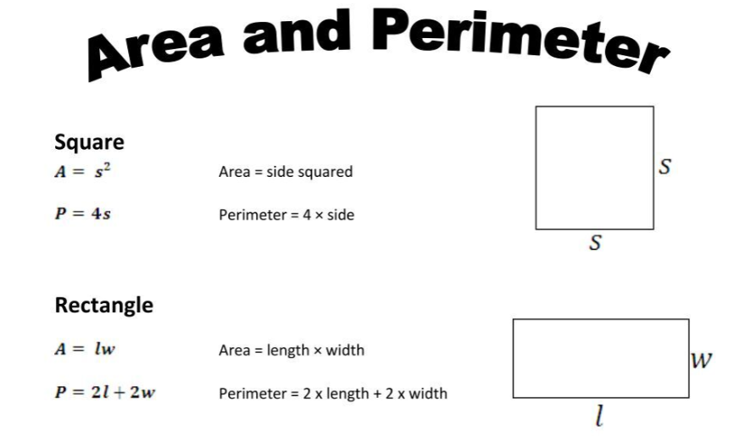
Let’s remember:

Slide 5
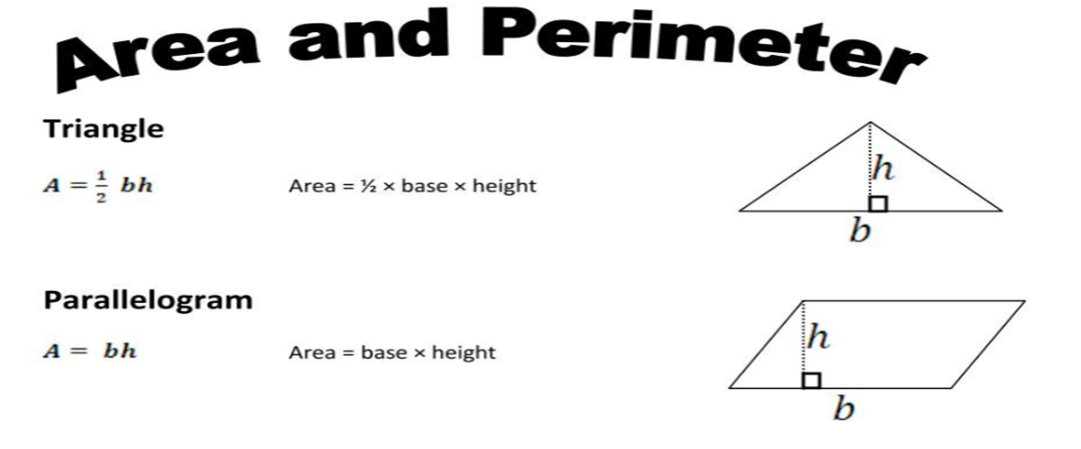
Let’s remember:

Slide 6
PRACTICE EXERCISE
Fifth grade
Math
INSPIRED BY

Slide 7
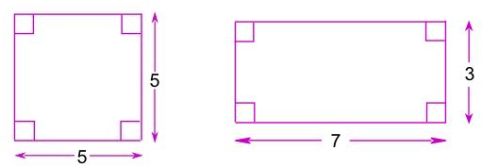

Find the area of the figures:
25
Square Units
21
Square Units

Slide 8
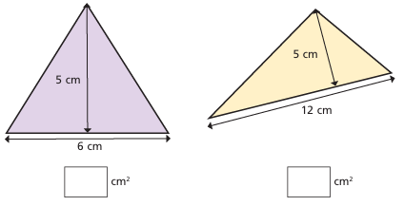
Find the area of the triangles:
15
30

Slide 9
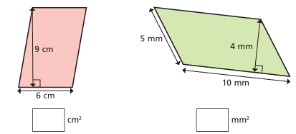
Find the area of the parallelograms:
54
40

Slide 10
AREA OF COMPOSITE FIGURES
DATE:_____________
INDICATOR: TO DISCOVER DIFFERENT METHODOLOGIES TO FIND OUT THE AREA OF COMPOSITE FIGURES.
Fifth grade
Math
INSPIRED BY

Slide 11
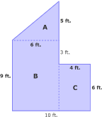
Warm-up!
Let’s watch the next video
https://www.youtube.com/watch?v=z4Lat1uOQI4
Finding the Area of a Composite Figure | Area of Composite Rectangles

Slide 12
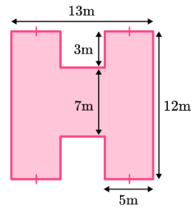
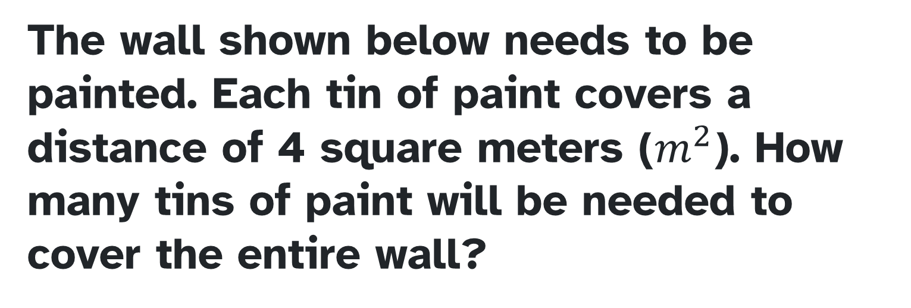
The area of the composite shapes is the area of combined shapes of one or more simple polygons and circles. In order to find the area of composite shapes, simply find the area of each shape and add them together.
The wall shown below needs to be painted. Each tin of paint covers a distance of 4 square meters ($m^{2}$). How many tins of paint will be needed to cover the entire wall?
https://thirdspacelearning.com/us/math-resources/topic-guides/geometry/area-of-composite-shapes/

Slide 13
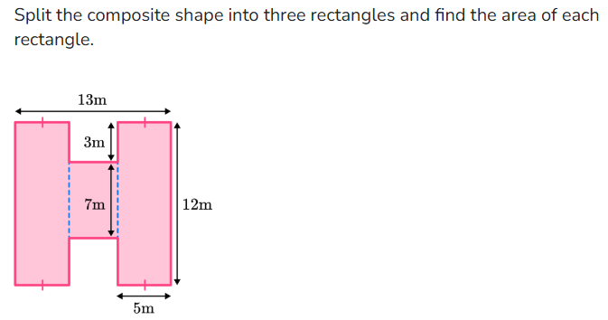

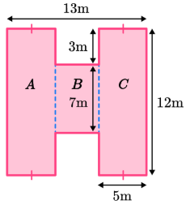

Slide 14
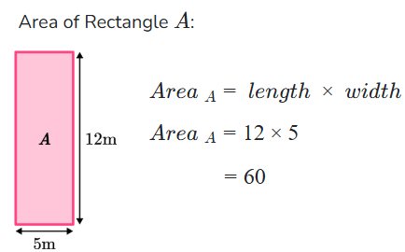

Slide 15
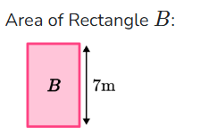
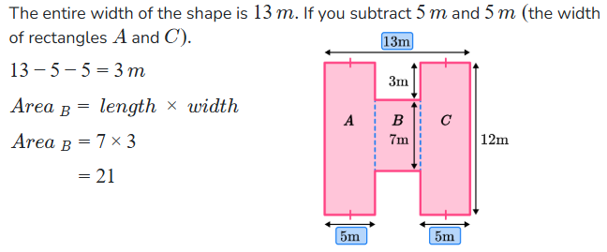

Slide 16
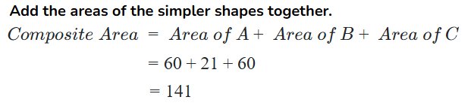
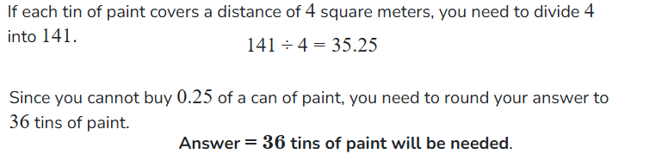

Slide 17
PRACTICE EXERCISE
Fifth grade
Math
INSPIRED BY

Slide 18
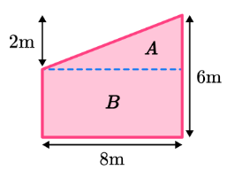
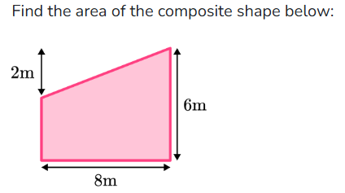
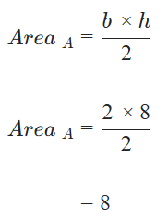
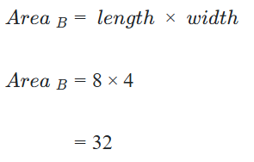
https://thirdspacelearning.com/us/math-resources/topic-guides/geometry/area-of-composite-shapes/

Slide 19
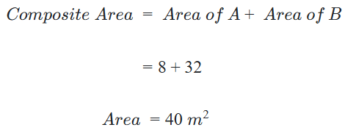

Slide 20
SHADED AREA OF FIGURES
DATE:_____________
INDICATOR: TO FIND OUT THE DIFFERENCE BETWEEN A SHADED AREA AND A NON-SHADED AREA.
Fifth grade
Math
INSPIRED BY

Slide 21
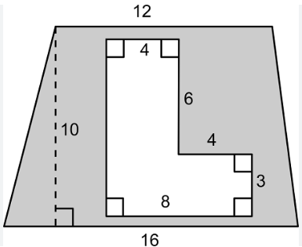
Warm-up!
Let’s watch the next video
https://www.youtube.com/watch?v=tmyUZ6XGFuY&t=5s
Area Of Compound Shapes // Shaded Regions // Problem Solving Questions

Slide 22
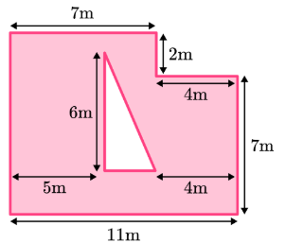
Below is a blueprint for a garden to be created in the middle of town. It will feature a triangular flowerbed and the remainder of the garden will be covered in grass.
Each roll of grass costs $24 and covers a distance of 3 square meters. How much will it cost to cover the garden with grass?

Slide 23
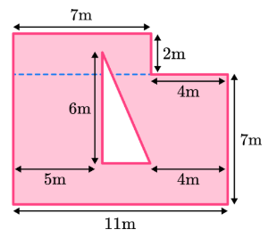
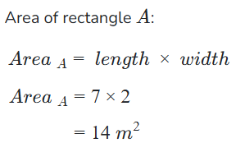
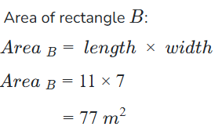

Slide 24
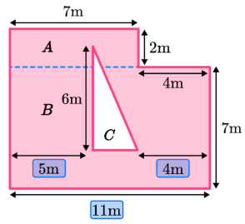
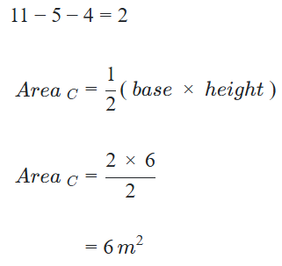
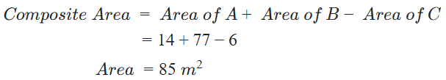

Slide 25
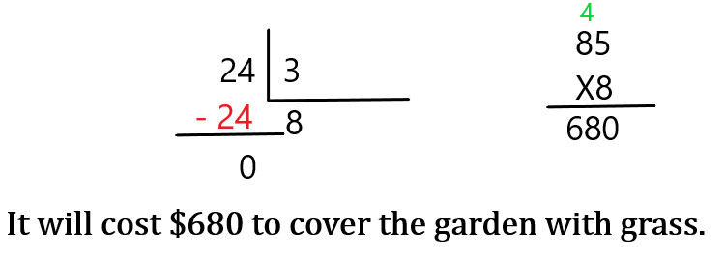

Slide 26
PRACTICE EXERCISE
Fifth grade
Math
INSPIRED BY

Slide 27
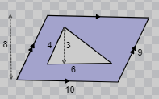



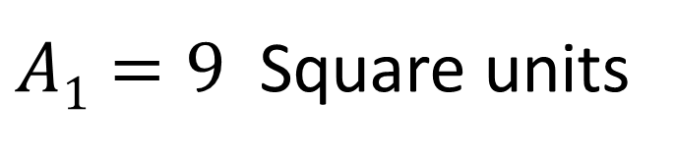
$$A1=\frac{6 X 3}{2}$$
$$A1=\frac{18}{2}$$
$A1=$ 9
$A1=9$ Square units

Slide 28

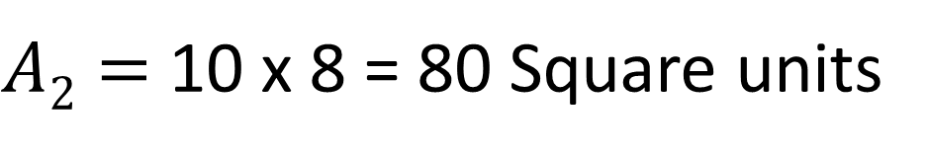
$A2=$ 10 x 8 = 80 Square units
$ATotal=80 −9 =71$ Square units

Slide 29
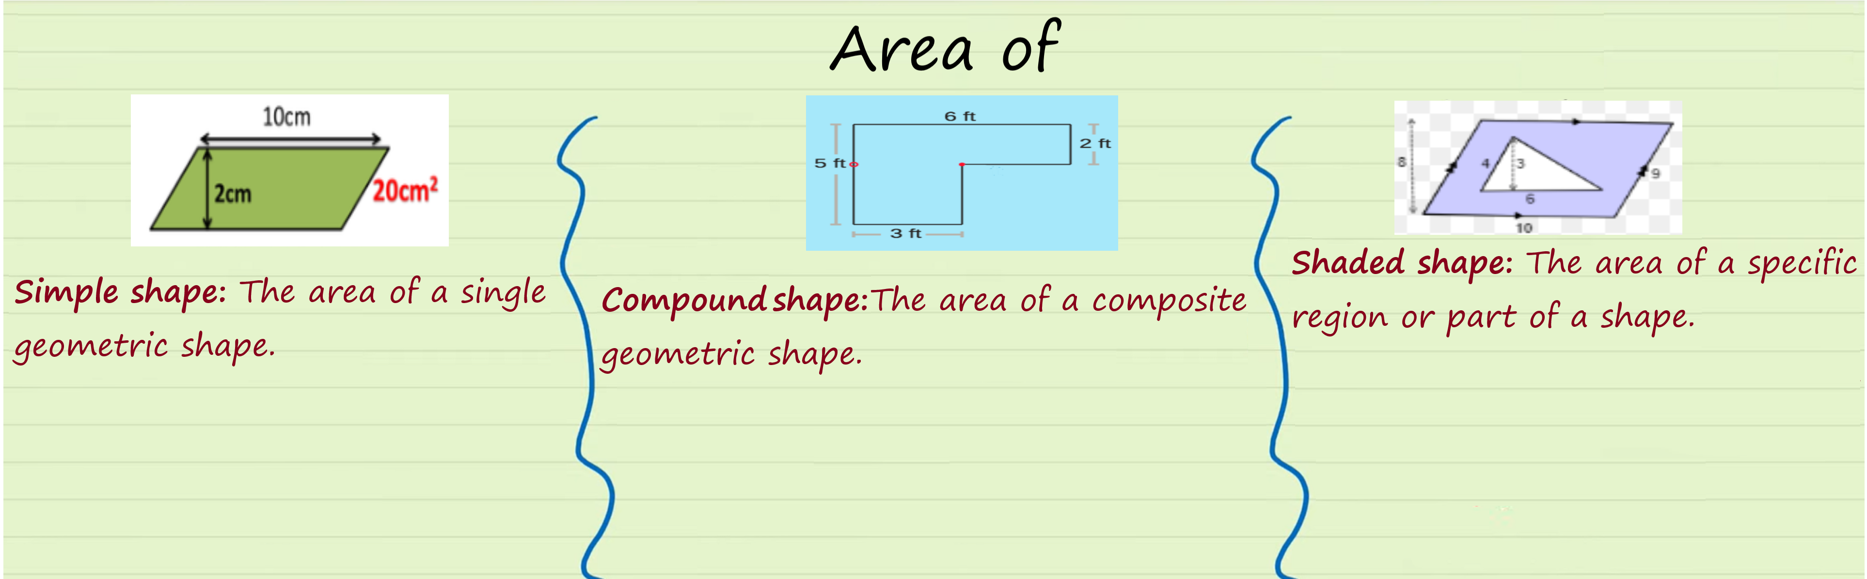
Synthesis

